Slide 1

Pancake And Noodle Detective Agency

Slide 2

The Case
Robbie the Raccoon
is on the run!
Detective Allan from
the Pancake And Noodle Detective Agency (P.A.N.D.A.)
is travelling around the world to track him down.
WANTED

Slide 3
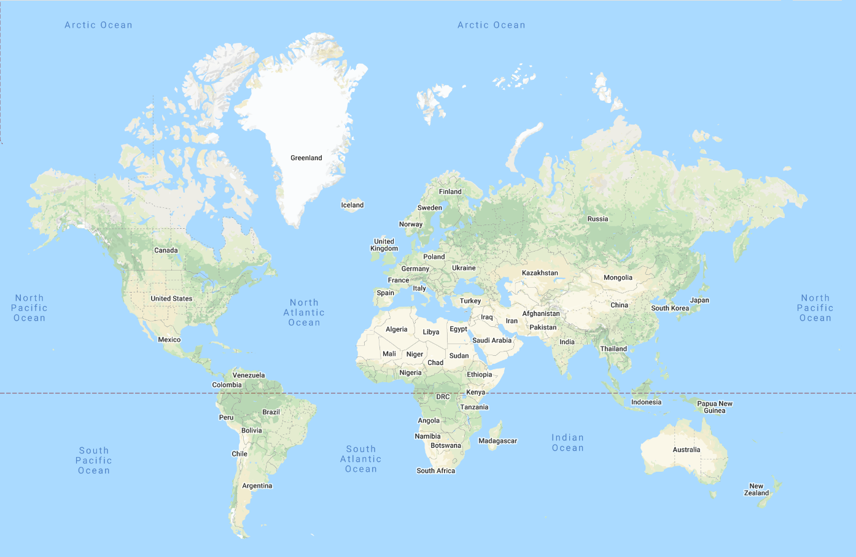






World Map
Before Allan left, he created this map of locations Robbie might be

Slide 4
P.A.N.D.A.
Each time Allan visits a city,
he sends a postcard back to the Detective Agency.
Allan has written part of each
postcard in code to stop people knowing where he has been.
The Agency has asked for our
help to decode the messages and
track down Robbie Raccoon!

Slide 5
Postcard 1
Offset Cypher

Slide 6


Postcard 1
Offset Cypher
H . L . K . K . F . Z . E . F T . X
The food here is amazing, but
I can’t seem to find Robbie in
Q . L . H . V . L
From,
Detective Allan
Pancake And Noodle Detective Agency
A → A+3

Slide 7
Postcard 1
Offset Cypher
H . L . K . K . F . Z . E . F T . X
Q . L . H . V . L
A → A+3
A | B | C | D | E | F | G | H | I | J | K | L | M | N | O | P | Q | R
S | T | U | V | W | X | Y | Z

Slide 8
Postcard 1
Offset Cypher
H . L . K . K . F . Z . E . F T . X
Q . L . H . V . L
A → A+3
A | B | C | D | E | F | G | H | I | J | K | L | M | N | O | P | Q | R
D
S | T | U | V | W | X | Y | Z

Slide 9
Postcard 1
Offset Cypher
H . L . K . K . F . Z . E . F T . X
Q . L . H . V . L
A → A+3
A | B | C | D | E | F | G | H | I | J | K | L | M | N | O | P | Q | R
D | E
S | T | U | V | W | X | Y | Z

Slide 10
Postcard 1
Offset Cypher
H . L . K . K . F . Z . E . F T . X
Q . L . H . V . L
A → A+3
A | B | C | D | E | F | G | H | I | J | K | L | M | N | O | P | Q | R
D | E | F | G | H | I | J | K | L | M | N | O | P | Q | R | S | T | U
S | T | U | V | W | X | Y | Z
V | W | X | Y | Z | A | B | C

Slide 11
Postcard 1
Offset Cypher
H . L . K . K . F . Z . E . F T . X
K
Q . L . H . V . L
A → A+3
A | B | C | D | E | F | G | H | I | J | K | L | M | N | O | P | Q | R
D | E | F | G | H | I | J | K | L | M | N | O | P | Q | R | S | T | U
S | T | U | V | W | X | Y | Z
V | W | X | Y | Z | A | B | C

Slide 12
Postcard 1
Offset Cypher
H . L . K . K . F . Z . E . F T . X
K . O . N . N . I . C . H . I W . A
Q . L . H . V . L
T . O . K . Y . O
A → A+3
A | B | C | D | E | F | G | H | I | J | K | L | M | N | O | P | Q | R
D | E | F | G | H | I | J | K | L | M | N | O | P | Q | R | S | T | U
S | T | U | V | W | X | Y | Z
V | W | X | Y | Z | A | B | C

Slide 13
Postcard 1
Offset Cypher
KONNICHI WA
The food here is amazing, but
I can’t seem to find Robbie in TOKYO
From,
Detective Allan
Pancake And Noodle Detective Agency
A → A+3

Slide 14
World Map

Slide 15

World Map

Slide 16
Postcard 2
Shape Grid

Slide 17
Postcard 2
Shape Grid
The scenery here is lovely,
but there doesn’t seem to be any sign of Robbie in
From,
Detective Allan
Pancake And Noodle Detective Agency

Slide 18
Postcard 2
Shape Grid
The other side of the postcard seems to contain some extra clues
N
Q
C

Slide 19
Postcard 2
Shape Grid
C
N
Q

Slide 20
Postcard 2
Shape Grid
There seems to be some sort of pattern to this grid.
Using the symbols
provided, can you work
out what labels need to
go down each side?

Slide 21
Postcard 2
Shape Grid
Now you have labelled the grid, can you use the extra clues to work out where the letters need to go?
Q
C
N

Slide 22
Postcard 2
Shape Grid
 |  | C
 |  |  | N
 | Q
Are you able to work out how to fill in the other letters?
Q
C
N

Slide 23
Postcard 2
Shape Grid
Now you should be able to decipher the message!
A | B | C | D | E
F | G | H | I | J
K | L | M | N | O
P | Q | R | S | T
U | V | W | X | Y Z

Slide 24
Postcard 2
Shape Grid
Now you should be able to decipher the message!
A | B | C | D | E
F | G | H | I | J
K | L | M | N | O
P | Q | R | S | T
U | V | W | X | Y Z
B
O
N
J
O
U
R
P
A
R
I
S

Slide 25
Postcard 2
Shape Grid
BONJOUR
The scenery here is lovely,
but there doesn’t seem to be any sign of Robbie in
PARIS
From,
Detective Allan
Pancake And Noodle Detective Agency

Slide 26
World Map

Slide 27
World Map

Slide 28
Postcard 3
Pictogram

Slide 29




Postcard 3
Pictogram
+
W
The weather here is gorgeous, but Robbie doesn’t seem to be in
Pancake And Noodle Detective Agency
N+ H
R +
OT + I
From, Detective Allan

Slide 30
Postcard 3
Pictogram
+
W
N+ H
R +
OT + I

Slide 31
Postcard 3
Pictogram
+
W
JAM + BOW
N+ H
R +
OT + I
N+ HAIR + ROBOT + I

Slide 32
Postcard 3
Pictogram
+
W
JAM + BOW
N+ H
R +
OT + I
N+ HAIR + ROBOT + I

Slide 33
Postcard 3
Pictogram
+
W
JAM + BO
N+ H
R +
OT + I
N + AI + ROB + I

Slide 34
Postcard 3
Pictogram
+
W
JAMBO
N+ H
R +
OT + I
NAIROBI

Slide 35
Postcard 3
Pictogram
JAMBO
The weather here is gorgeous, but Robbie doesn’t seem to be in
NAIROBI
Pancake And Noodle Detective Agency
From, Detective Allan

Slide 36
World Map

Slide 37
World Map

Slide 38
Postcard 4
Book Code

Slide 39
Postcard 4
Book Code
1.2.4 2.4.6 5.7.3 3.3.2 2.3.1 5.2.1 1.6.2
The people are really friendly but there’s no trace of Robbie in 2.1.1 4.5.5 5.3.1
1.3.4 3.4.12 2.3.5 2.3.5 3.2.1
From,
Detective Allan
Pancake And Noodle Detective Agency

Slide 40
Postcard 4
Book Code
The other side postcard feature some panda facts
The giant panda is a bear
native to south central China.
It is easily recognisable
by its black and white fur.
In the wild, pandas only eat bamboo.
3.4.5 5.4.5 2.2.1

Slide 41
Postcard 4
Book Code
The giant panda is a bear
native to south central China.
It is easily recognisable
by its black and white fur.
In the wild, pandas only eat bamboo.
3.4.5
5.4.5
2.2.1
1.2.4
2.4.6
5.7.3
3.3.2
2.3.1
5.2.1
1.6.2
2.1.1
4.5.5
5.3.1
1.3.4
3.4.12
2.3.5
4.3.2
3.2.1

Slide 42

Postcard 4
Book Code
The giant panda is a bear
native to south central China.
It is easily recognisable
by its black and white fur.
In the wild, pandas only eat bamboo.
3.4.5
5.4.5
2.2.1
1.2.4
Line 1

Slide 43
Postcard 4
Book Code
The giant panda is a bear
native to south central China.
It is easily recognisable
by its black and white fur.
In the wild, pandas only eat bamboo.
3.4.5
5.4.5
2.2.1
1.2.4
Line 1
Word 2

Slide 44
Postcard 4
Book Code
The giant panda is a bear
native to south central China.
It is easily recognisable
by its black and white fur.
In the wild, pandas only eat bamboo.
3.4.5
5.4.5
2.2.1
1.2.4
Line 1
Letter 4
Word 2

Slide 45
Postcard 4
Book Code
The giant panda is a bear
native to south central China.
It is easily recognisable
by its black and white fur.
In the wild, pandas only eat bamboo.
3.4.5
5.4.5
2.2.1
1.2.4
2.4.6
5.7.3
3.3.2
2.3.1
5.2.1
1.6.2
2.1.1
4.5.5
5.3.1
1.3.4
3.4.12
2.3.5
4.3.2
3.2.1

Slide 46
Postcard 4
Book Code
The giant panda is a bear
native to south central China.
It is easily recognisable
by its black and white fur.
In the wild, pandas only eat bamboo.
3.4.5
5.4.5
2.2.1
1.2.4
2.4.6
5.7.3
3.3.2
2.3.1
5.2.1
1.6.2
N
2.1.1
4.5.5
5.3.1
1.3.4
3.4.12
2.3.5
4.3.2
3.2.1

Slide 47
Postcard 4
Book Code
The giant panda is a bear
native to south central China.
It is easily recognisable
by its black and white fur.
In the wild, pandas only eat bamboo.
3.4.5
5.4.5
2.2.1
1.2.4
2.4.6
5.7.3
3.3.2
2.3.1
5.2.1
1.6.2
N
A
M
A
S
T
E
2.1.1
4.5.5
5.3.1
1.3.4
3.4.12
2.3.5
4.3.2
3.2.1
N
E
W
D
E
H
L
I

Slide 48
Postcard 4
Book Code
NAMASTE
The people are really friendly but there’s no trace of Robbie in NEW DEHLI
From,
Detective Allan
Pancake And Noodle Detective Agency

Slide 49
World Map

Slide 50
World Map

Slide 51
Postcard 5
Semaphore

Slide 52










Postcard 5
Semaphore
The culture here is incredible, but not luck finding Robbie in
From,
Detective Allan
Pancake And Noodle Detective Agency

Slide 53




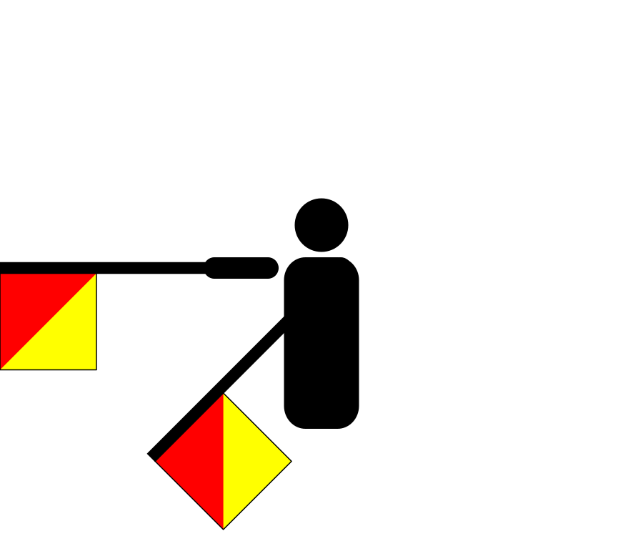
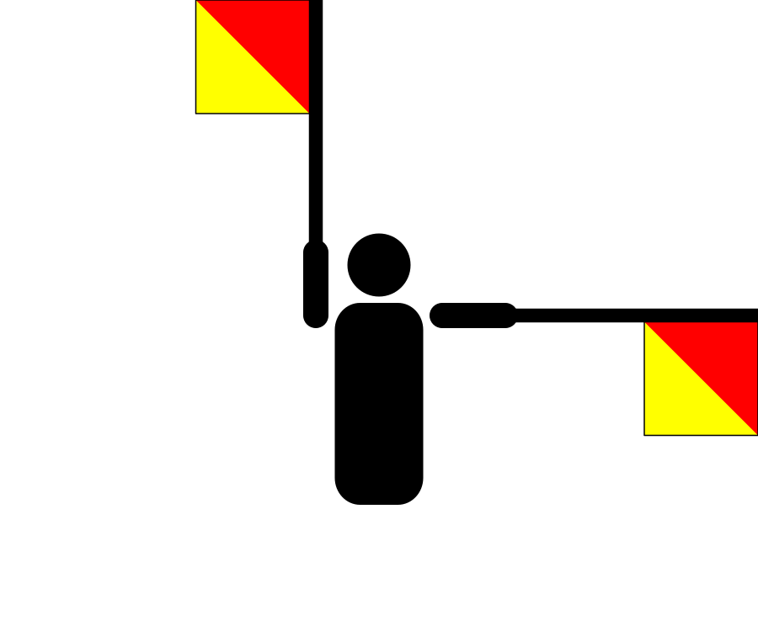

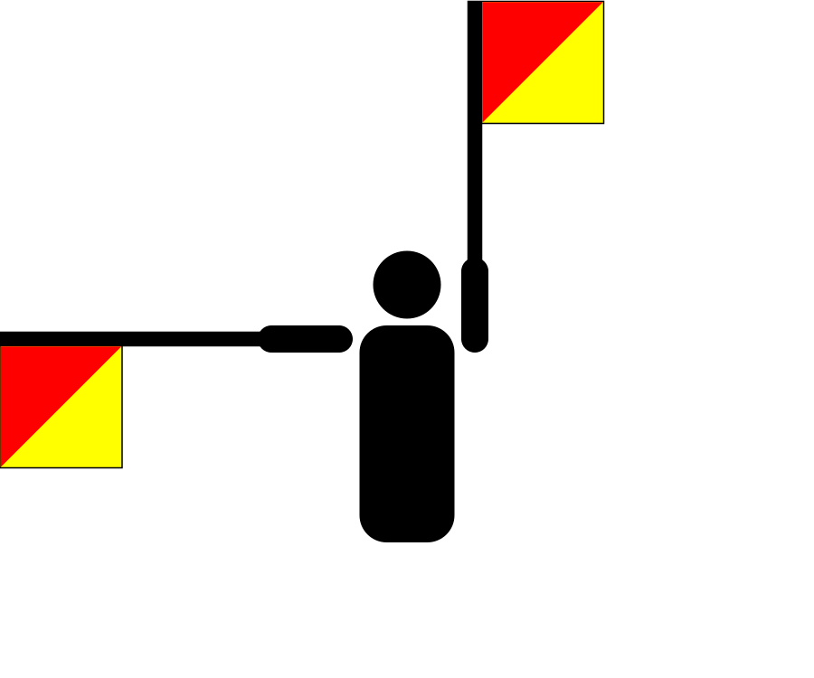

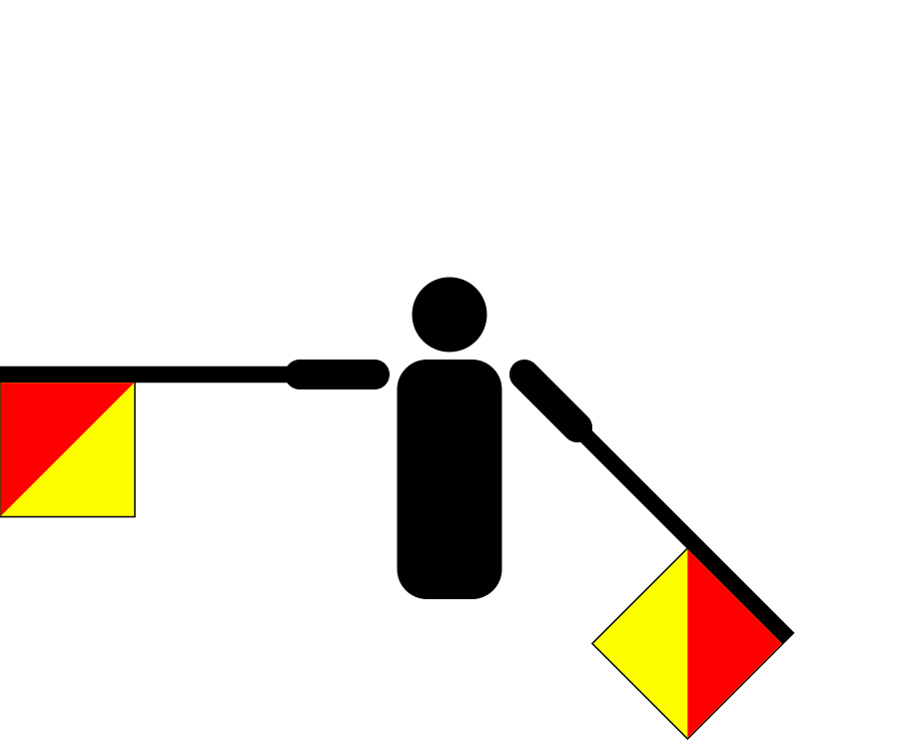






Postcard 5
Semaphore
The other side of the postcard seems to contain some extra clues
A
B
C
D
E
F
G
H
I
J
K
L
M
N
O
P
Q
R
S
T
U
V
W
X
Y
Z

Slide 54
Postcard 5
Semaphore
A
B
C
D
E
F
G
H
I
J
K
L
M
N
O
P
Q
R
S
T
U
V
W
X
Y
Z

Slide 55
Postcard 5
Semaphore
A
B
C
D
E
F
G
H
I
J
K
L
M
N
O
P
Q
R
S
T
U
V
W
X
Y
Z
K
I
A
O
R
A
A
U
C
K
L
A
N
D

Slide 56
Postcard 5
Semaphore
KIA ORA
The culture here is incredible, but not luck finding Robbie in
AUCKLAND
From,
Detective Allan
Pancake And Noodle Detective Agency

Slide 57
World Map

Slide 58
World Map

Slide 59

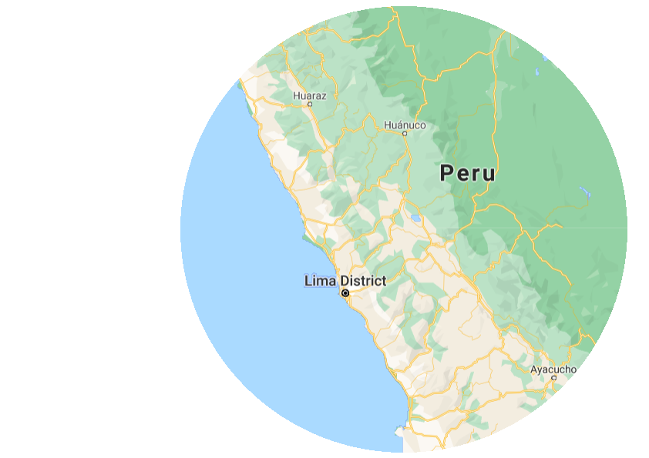
World Map

Slide 60
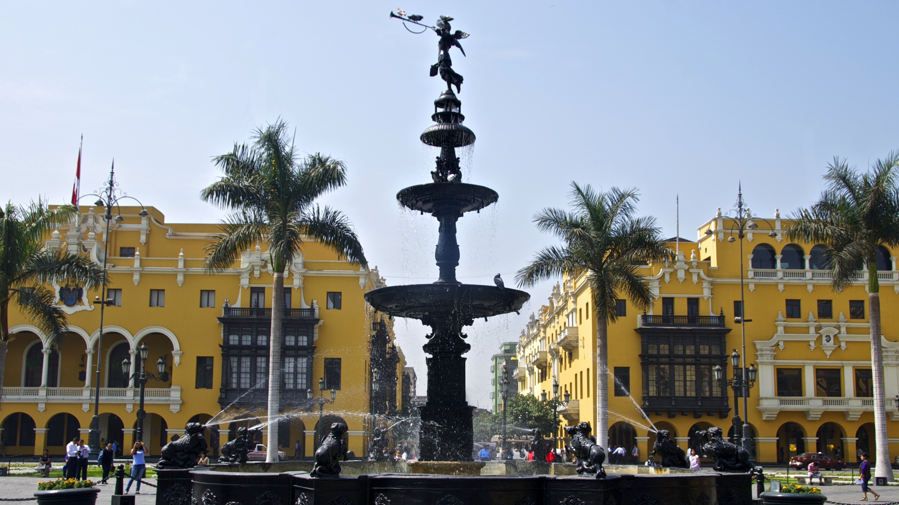

Case Closed

Slide 61
Pancake And Noodle Detective Agency

