Slide 1
Grid References

Slide 2
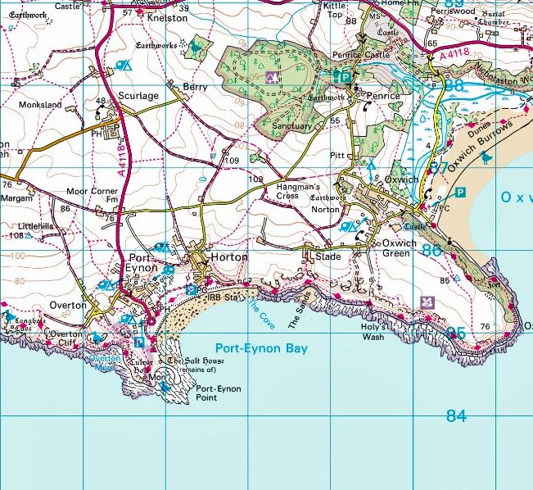

What are Grid References?
Maps can be very big, so are often broken down into small squares
When placed side by side, these
small squares form a grid
The grid reference identifies a
location within this grid
Can you see the grid?

Slide 3
Grid Reference
Basics

Slide 4

Grid Reference Basics
7
6
5
Each line is labelled so that it is easy to identify
4
3
2
1
A
B
C
D
E
F
G

Slide 5

Grid Reference Basics
7
6
In most cases, the labels start at the bottom left corner and go up in order
5
4
3
2
1
A
B
C
D
E
F
G

Slide 6


Grid Reference Basics
7
Grid references can be split into two parts
D3
6
5
4
3
2
Label on the bottom
Label on the side
1
A
B
C
D
E
F
G

Slide 7
Grid Reference Basics
7
D3
6
5
If we find this location on the map, you will see that it is in the middle of 4 squares
4
3
X
2
1
A
B
C
D
E
F
G

Slide 8
Grid Reference Basics
7
D3
6
5
The grid reference
will always be in the
bottom-left corner of the square it represents
4
3
X
2
1
A
B
C
D
E
F
G

Slide 9
Grid Reference Basics
7
Can you find the grid references for the following?
Square
Circle
Triangle
Star
6
5
4
3
2
1
A
B
C
D
E
F
G

Slide 10
Grid Reference Basics
7
Can you find the grid references for the following?
Square C5
Circle B1
Triangle E3
Star E4
6
5
4
3
2
1
A
B
C
D
E
F
G

Slide 11
Four Figure
Grid References

Slide 12

Four Figure Grid References
7
6
As there are only 26 different letters,
it is more common for the lines to be labelled with a number
5
4
3
2
1
A
B
C
D
E
F
G

Slide 13
Four Figure Grid References
7
6
5
These numbers may not start at 1, as you might be looking at a section of a much bigger map
4
3
2
1
21
22
23
24
25
26
27

Slide 14
Four Figure Grid References
07
06
05
In cases where numbers only have 1 digit,
we put a 0 in front
04
03
02
01
21
22
23
24
25
26
27

Slide 15
Four Figure Grid References
07
?
Otherwise it ca be hard to tell whether
212
is meant to represent
212 Or 212
06
05
04
03
02
01
21
22
23
24
25
26
27

Slide 16
Four Figure Grid References
07
Can you draw lines between the following points to create a shape?
Put the maker in the bottom-left corner of the square
06
05
04
03
2202 -> 2306
2306 -> 2603
2603 -> 2202
02
01
21
22
23
24
25
26
27

Slide 17
Four Figure Grid References
07
Can you draw lines between the following points to create a shape?
Put the maker in the bottom-left corner of the square
06
05
04
03
2202 -> 2306
2306 -> 2603
2603 -> 2202
02
01
21
22
23
24
25
26
27

Slide 18
Order Matters

Slide 19
Order Matters
41
40
39
In some cases, the same numbers will appear both the bottom and the side of the grid
38
37
36
35
37
38
39
40
41
42
43

Slide 20
Order Matters
We therefore always
give the number along
the bottom first, then
the number up the side
Otherwise it would be hard to tell the difference between these two references
3840 4038
41
40
39
38
37
36
35
37
38
39
40
41
42
43

Slide 21



Order Matters
To remember the correct order, some people use the saying
“Walk along the corridor, then go up the stairs”

Slide 22
Order Matters
39
Can you write the following letters in the correct position on the grid?
A = 3433
B = 3735
C = 3837
D = 3536
E = 3438
F = 3335
38
37
36
35
34
33
33
34
35
36
37
38
39

Slide 23
Order Matters
39
 | E
 |  |  |  |  | C
 |  | D
F |  |  |  | B
 | A
Can you write the following letters in the correct position on the grid?
A = 3433
B = 3735
C = 3837
D = 3536
E = 3438
F = 3335
38
37
36
35
34
33
33
34
35
36
37
38
39

Slide 24
Six Figure
Grid References

Slide 25
Six Figure Grid References
07
06
Four figure grid references are useful to give a rough location, but sometimes the area the square represents is still very large
05
04
03
02
01
21
22
23
24
25
26
27

Slide 26

Six Figure Grid References
To give a more accurate reference, you can imagine the square is broken down into an even smaller grid made up of 10 columns and 10 rows
(or 100 little squares)

Slide 27
Six Figure Grid References
Six figure grid references give the location using a combination of the big and little grid
244036
04
9
8
7
6
5
4
3
2
1
03
0
0
1
2
3
4
5
6
7
8
9
24
25

Slide 28


Six Figure Grid References
The grid reference can still be split into two
244 036
04
9
8
7
6
5
4
3
2
1
03
0
Label on the bottom
Label on the side
0
1
2
3
4
5
6
7
8
9
24
25

Slide 29



Six Figure Grid References
The first 2 numbers within each half represent the
big grid, and the last number is the smaller grid
04
9
8
Four figure reference from the big grid
7
6
5
4
3
244 036
2
1
03
0
0
1
2
3
4
5
6
7
8
9
Extra 2 digits from the little grid
24
25

Slide 30
Six Figure Grid References
In most cases, the smaller grid isn’t actually drawn on the map
To work out the extra numbers for the grid reference, you just have to imagine that it is there
04
9
8
7
6
5
4
3
2
1
03
0
0
1
2
3
4
5
6
7
8
9
24
25

Slide 31
Six Figure Grid References
27
Can you estimate the six figure grid references for the following?
Red
Blue
Green
Purple
Yellow
26
25
16
17

Slide 32
Six Figure Grid References
27
Can you estimate the six figure grid references for the following?
Red
Blue
Green
Purple
Yellow
26
25
16
17

Slide 33
Six Figure Grid References
27
Can you estimate the six figure grid references for the following?
Red 160266
Blue 169256
Green 163251
Purple 166263
Yellow 164259
26
25
16
17

Slide 34
Eight Figure
Grid References

Slide 35



Eight Figure Grid References
If a six figure grid reference still isn’t accurate enough,
you can repeat the process to create eight figure grid references
24470365
Six figure reference
Two extra digits

Slide 36
Eight Figure Grid References
This could be repeated again and again to get a
10 or 12 digit reference, but we rarely use anything bigger than an eight figure reference
2447203651
244725036512

Slide 37
Ordnance Survey (OS) Maps

Slide 38
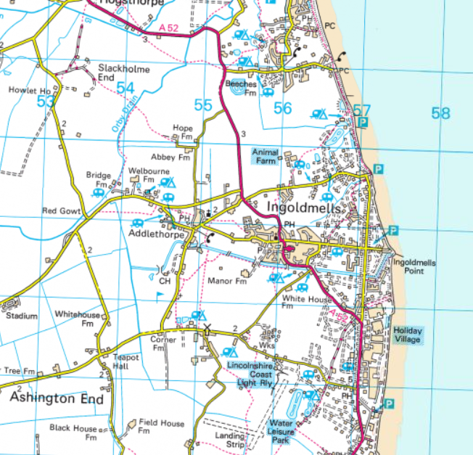
Ordnance Survey Maps
One of the most common
types of maps you will
use in Scouting is an
Ordnance Survey (OS) Map
These cover the entire of the UK, an have a very distinctive appearance

Slide 39
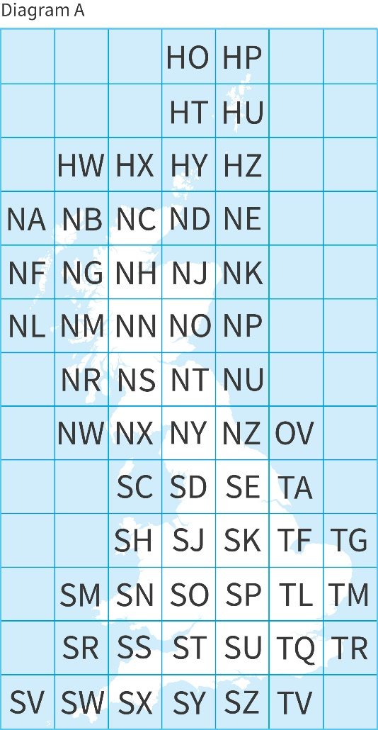
Ordnance Survey Maps
Because the UK is so large, it would be impossible to fit onto one paper map
It has therefore been split down into smaller squares, with each square labelled with a two-letter name

Slide 40
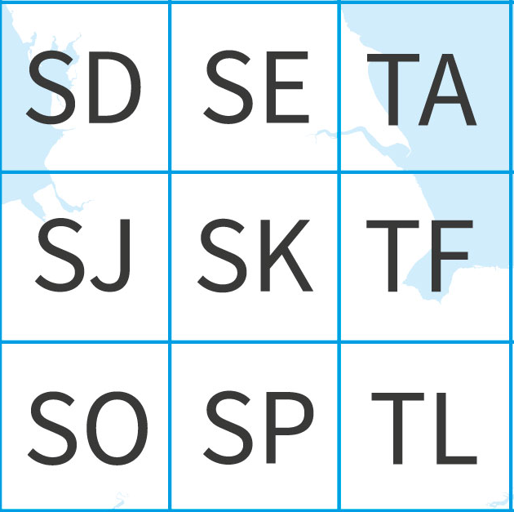
Ordnance Survey Maps
UK grid references often have these 2 letters at the start
SK 432454
This helps people know what part of map they need to look at to find the reference

Slide 41
Ordnance Survey Maps
Each of these squares represents an area
that is 100km wide and 100km tall
100km
100km
100km
100km
100km
100km

Slide 42
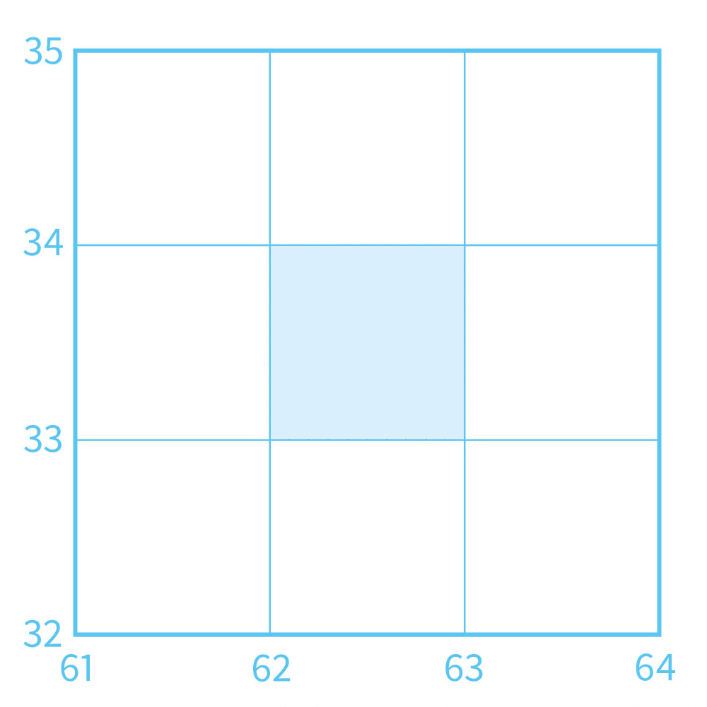
Ordnance Survey Maps
Zooming into each of the 2-letter squares, you will find the grid used to work out a 4 figure grid reference.
This means that the area covered by a 4 figure grid reference is
1km wide and 1km tall
1km
1km

Slide 43
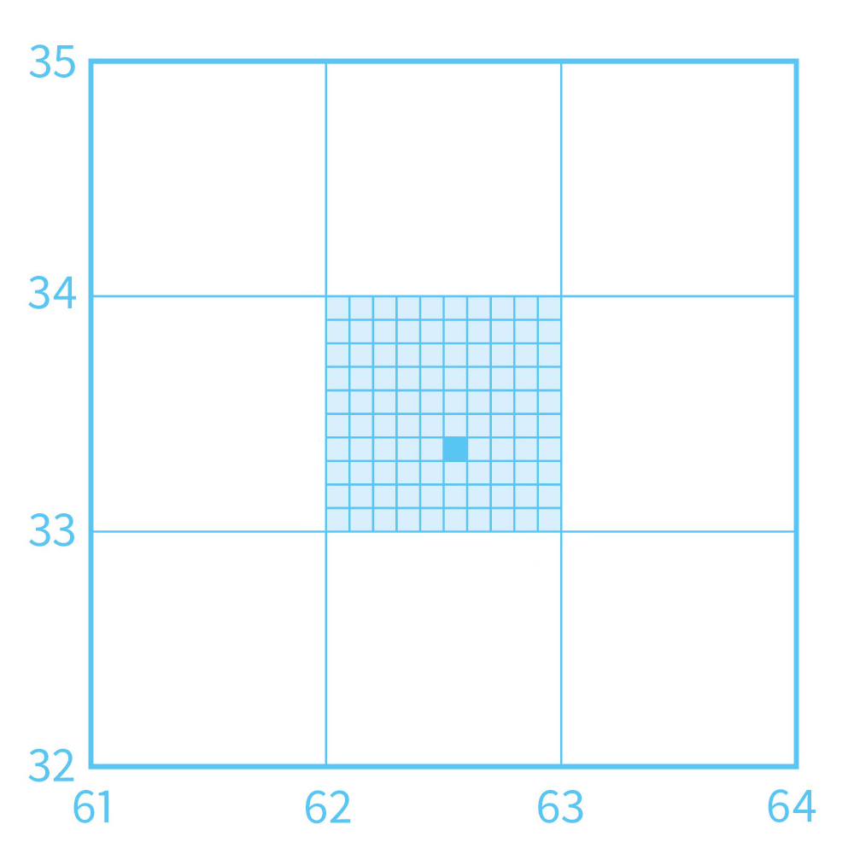

Ordnance Survey Maps
To work out the 6 figure grid reference, you have to split the 1km x 1km square into 10 rows and 10 columns.
This means that the area covered by a 6 figure grid reference is
100m wide and 100m tall
100m x 100m

Slide 44
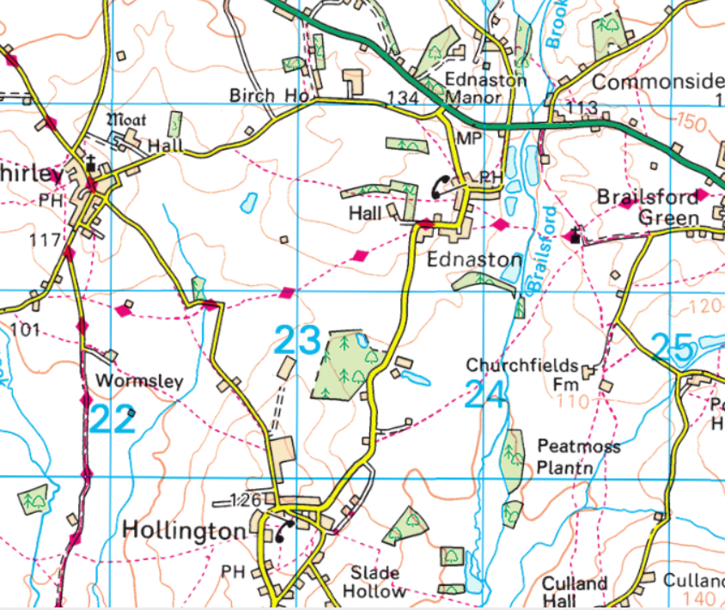

Ordnance Survey Maps
On printed maps, the numbers for the 4 figure grid references are written on the lines.
However, they aren’t always in the same
place as they need to make sure they don’t cover a landmark

Slide 45
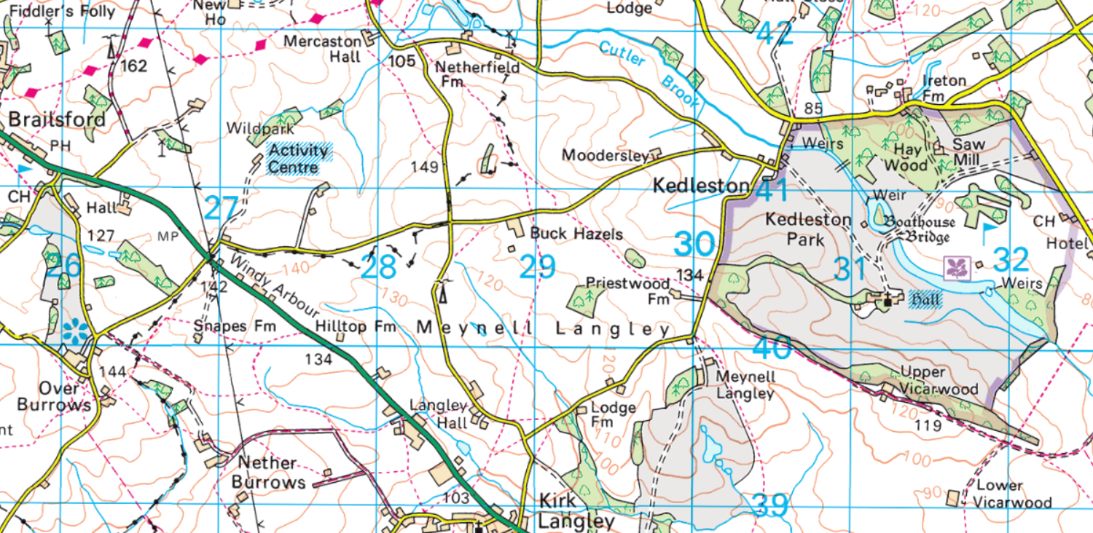
Ordnance Survey Maps
What landmarks are at the following 6 figure grid references?
268401
316391

Slide 46


Ordnance Survey Maps
What landmarks are at the following 6 figure grid references?
268401
Snapes Fm
316391
Lower Vicarwood

Slide 47
Painting
By References

Slide 48
Painting By References
Draw or print a 10x10 grid on a piece of paper
10
09
08
07
06
05
Label the grid from 00 to 10 on each side
04
03
02
01
00
00
01
02
03
04
05
06
07
08
09
10

Slide 49
Painting By References
Use the references below to colour in the correct squares
Green
Red
Blue
Yellow
0000
0100
0200
0300
0400
0500
0600
0700
0800
0900
0201
0202
0203
0204
0304
0404
0504
0503
0502
0501
0601
0701
0801
0802
0803
0804
0704
0604
0205
0305
0405
0505
0605
0705
0805
0706
0606
0506
0406
0306
0407
0507
0607
0508
0301
0401
0302
0402
0303
0403
0602
0702
0603
0703
0307
0308

Slide 50
Painting By References
10
09
08
07
06
05
04
03
02
01
00
00
01
02
03
04
05
06
07
08
09
10

Slide 51
Dot-to-Dot

Slide 52
Dot-to-Dot
Draw or print a 10x10 grid on a piece of paper
10
09
08
07
06
05
Label the grid from 00 to 10 on each side
04
03
02
01
00
00
01
02
03
04
05
06
07
08
09
10

Slide 53
Dot-to-Dot
Draw lines between the following sets of points.
Put the maker in the bottom-left corner of the grid reference
0103 → 0109 → 0307 → 0707 → 0909 → 0903 → 0701 → 0301 → 0103
0503 → 0404 → 0604 → 0503 → 0502
0303 → 0402 → 0602 → 0703
0405 → 0406
0605 → 0606

Slide 54
Dot-to-Dot
10
09
08
07
06
05
04
03
02
01
00
00
01
02
03
04
05
06
07
08
09
10

Slide 55
Make your own

Slide 56
Make your own
10
Use the knowledge
you have gained to make your own
‘Painting by reference’ or
dot-to-dot picture
Why not share it
with your friends
and see if they can complete it?
09
08
07
06
05
04
03
02
01
00
00
01
02
03
04
05
06
07
08
09
10

